Slide 1

Suraksha COVID19
By- Shubhayan Saha, Soumya Sinha, Archit Sharma, Arya S Bandopadhyay, Ravi Teja

Slide 2

One Stop for all the information you need regarding the Pandemic.

Slide 3
Current problems
There is NO single place to get all the information related to the pandemic in world or indian dashboards.
Nearest test health centres are difficult to locate.
NO ONE is aware of the availability of hospitals in rural and urban areas.
Awareness in between citizens of the government policies and implementation been done at the time of pandemic.
USA | Iran | Italy | India

Slide 4

The solution
Providing Country Wise statistics updated dynamically.
Live Global and Nationwide Headlines to prevent people from fake news.
A diagnosis test yourself section for people feeling the symptoms of the virus.
A live map to inform people to locate there nearest test centres.
Hospital bed availability in there area.
For facilitate the citizens we provide government schemes, policies and donation funds information all at one place.
Live Chat Assistance to keep you updated.
Regional Language Support.
Providing Country Wise statistics updated dynamically.
Live Global and Nationwide headlines to prevent people from fake news.
A diagnosis test yourself section for people feeling the symptoms of the virus.
A live map to inform people to locate there nearest test centres.
Hospital bed availability in there area.
For facilitate the citizens we provide government schemes, policies and donation funds information all at one place.

Slide 5

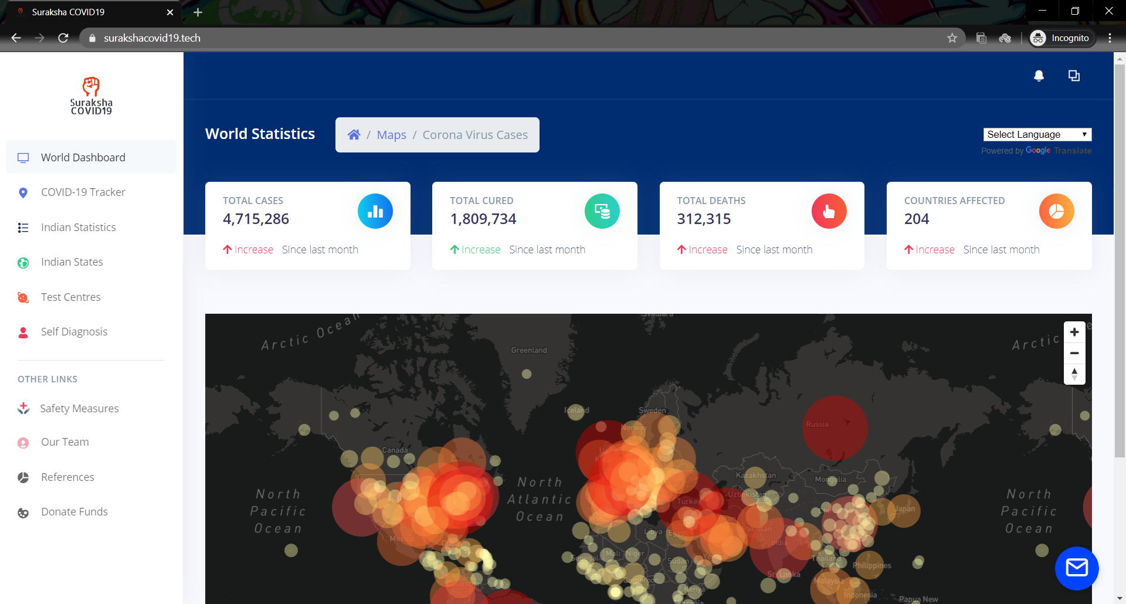

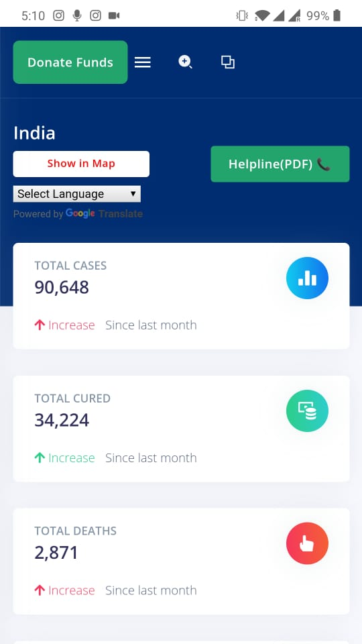
Our Dashboard

Slide 6
Technological Implementation
Artificial Intelligence
Machine Learning
Search Engine Optimization
Data Analytics
Web Development
Mobile Responsive

Slide 7
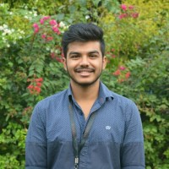


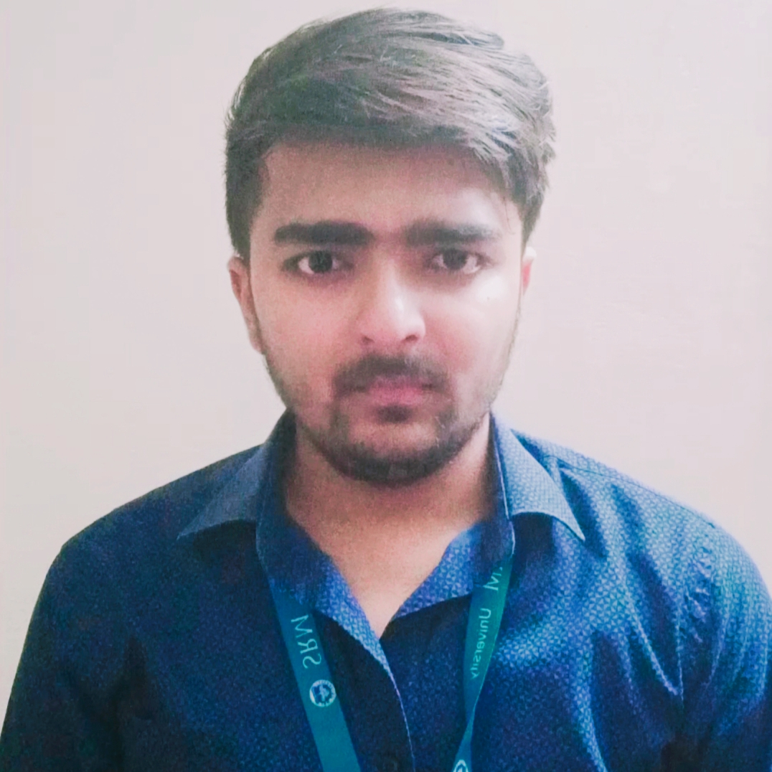
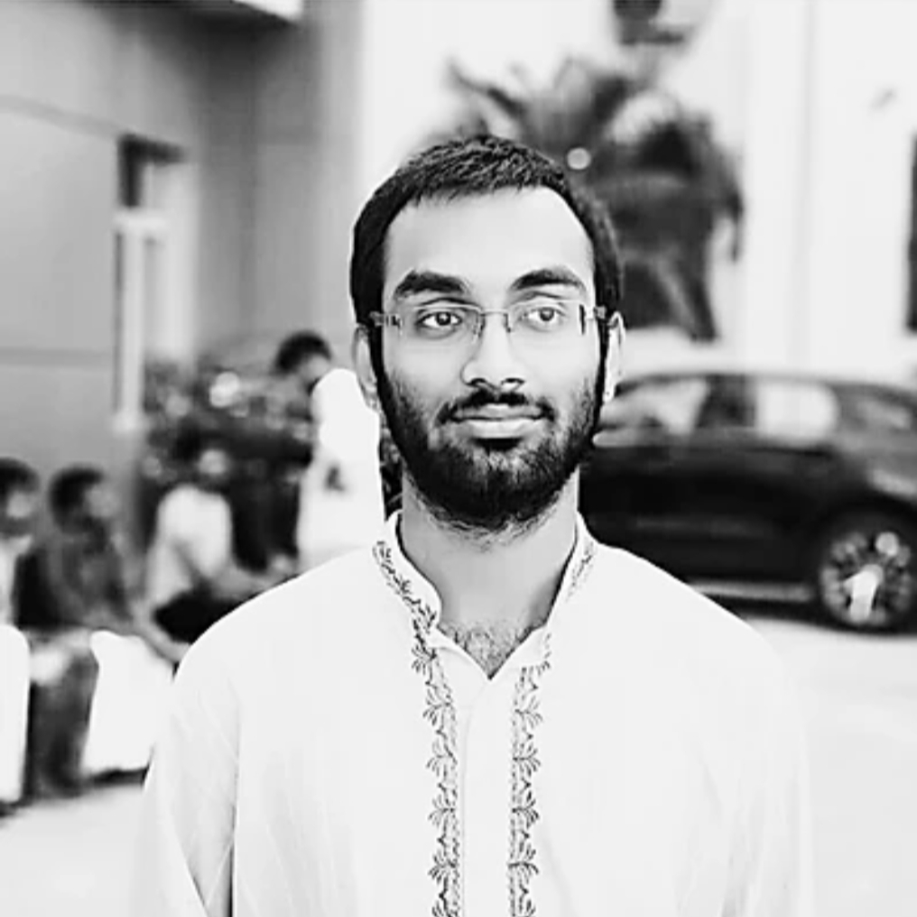
Our Team
Shubhayan Saha
Soumya Sinha
Arya S
Bandhopadhyay
Ravi Teja CMS
Archit Sharma
Artificial Intelligence, Full Stack Developer
Data Analysis, Frontend Web Developer
Data Analysis, Full Stack Developer,Blockchain
Full Stack Developer
DevOps, Full Stack Developer

Slide 8

Thank You!

